Slide 1
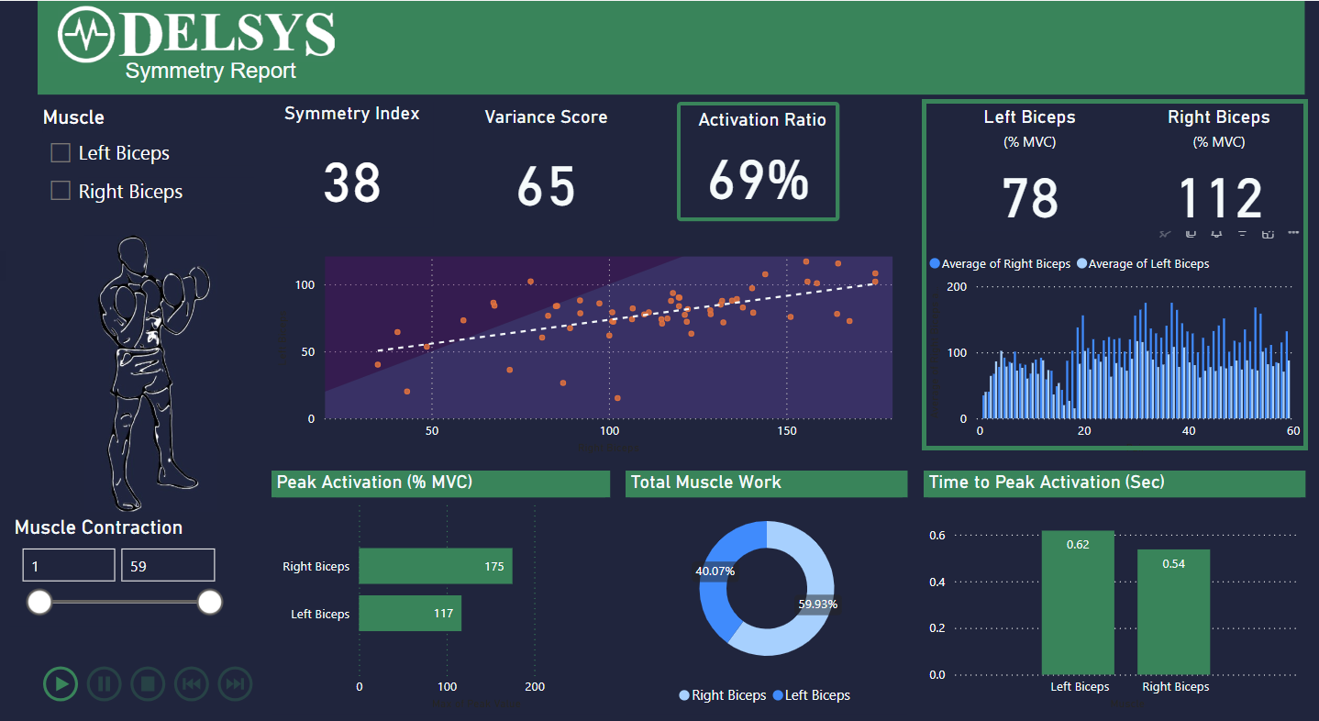
A
F
B
C
D
E
G
J
K
L
= Adjustable Parameter
H
= Adjusted Metric
I
A – Adjustable window to select muscle(s) for analysis + comparison.
B – Y-intercept of line of best fit in E. “You’re asymmetrical by 38%.”
C – 1-r^2 value from line of best fit in E. When the value is higher, D is less repeatable.
D – Ratio of values in F.
E – Plot showing relationship of activation for each contraction, within the window of muscle contractions set at H. X-axis is one muscle (R Biceps here), and Y-axis is other muscle (L Biceps here).
F – Average % MVC of each muscle, using the Integral % MVC of each contraction, within the window of muscle contractions set at H.
G – Bar graph showing the Integral % MVC of each muscle during each contraction, within the window of muscle contractions set at H. X-axis is # of Muscle Contractions, Y-axis is % MVC.
H – Adjustable window to set the # of muscle contractions to observe.
I – Playback feature, allowing you to see how the metrics change as more contractions are added over the duration of the trial.
J – Peak Activation for each muscle, within the window of muscle contractions set at H.
K – % of the sum of each muscle’s Integrated % MVC, within the window of muscle contractions set at H.
L – Average Time to reach the Peak Activation, starting from the onset of muscle contraction, for all contractions within the window of muscle contractions set at H.

